Slide 1
K-Dimensional Trees
Alexander Raschl | K01556188
Markus Laube | K01557290
Stefan Brandl | K01555842

Slide 2
Introduction
Invented by Jon Louis Bentley in 1975
Index structure for managing multidimensional objects
k is the dimensionality of the search space
Space partitioning is performed via building a binary search tree
Each node is equal to a k-dimensional point
Performs only axis aligned splits

Slide 3
Application Domain
Mostly theoretical
Can be used for
Nearest Neighbor Search
Search k-dimensional point in tree nearest to a given point
Suffers from curse of dimensionality
Range searches
Search for ranges of attributes
For example query income-ranges for persons
Worst complexity O(k * N^(1-1/k))

Slide 4
Complexity
Action | Average Complexity | Worst Complexity
Space | O(n) | O(n)
Insertion | O(log n) | O(n)
Query | O(log n) | O(n)
Removal | O(log n) | O(n)

Slide 5
Examples
Construction
Insertion
Deletion
Query / Lookup
NN-Search

Slide 6
Construction

Slide 7
Construction
as long as >= 1 element remaining: Pick a split dimension (f.e. x or y)
canonical (increasing)
random
Compute the median
Axis aligned split into left and right subtree at median
repeat 1

Slide 8
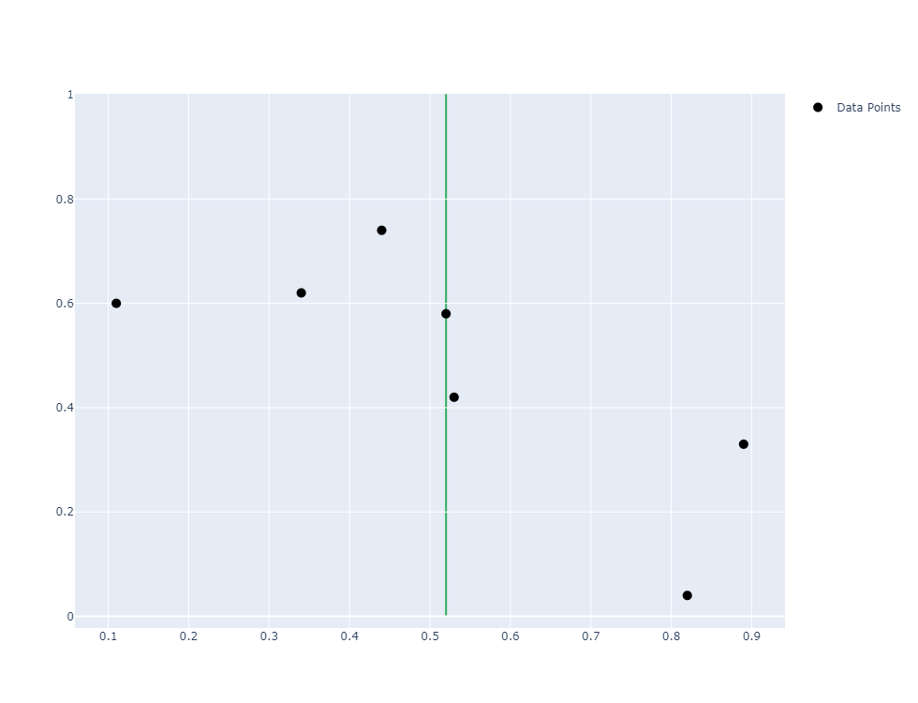


Slide 9
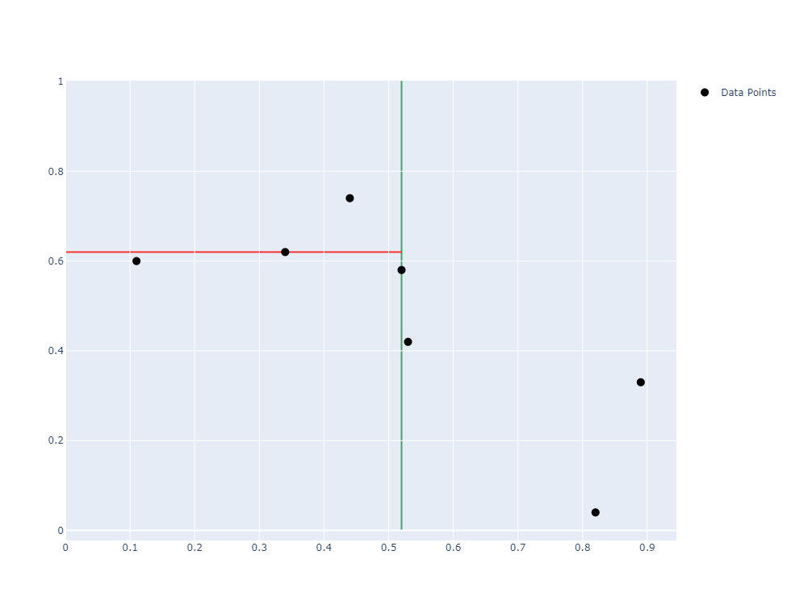
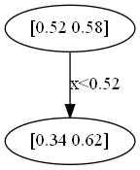

Slide 10
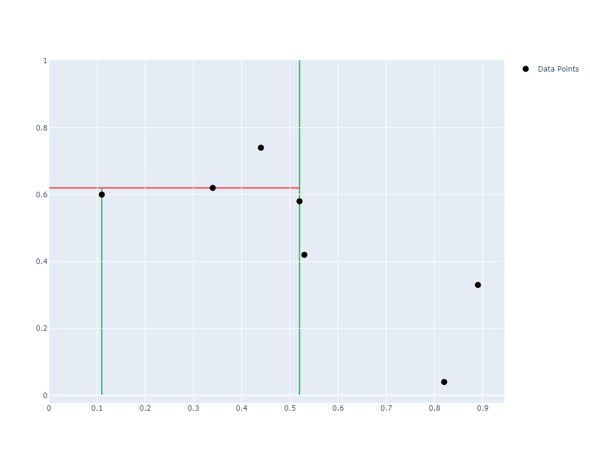
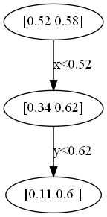

Slide 11
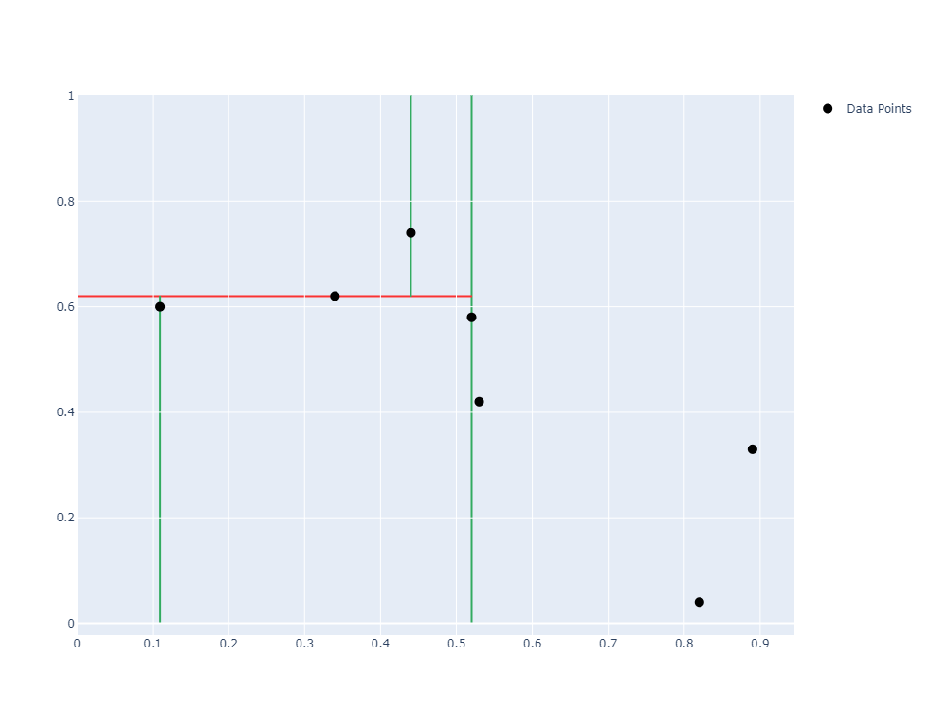
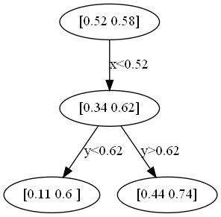

Slide 12
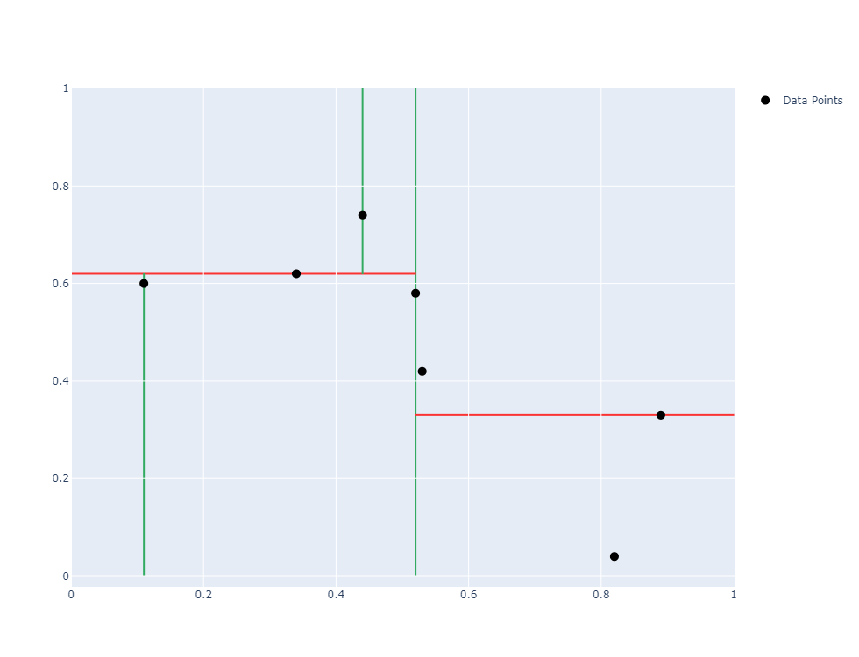
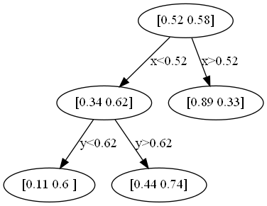

Slide 13
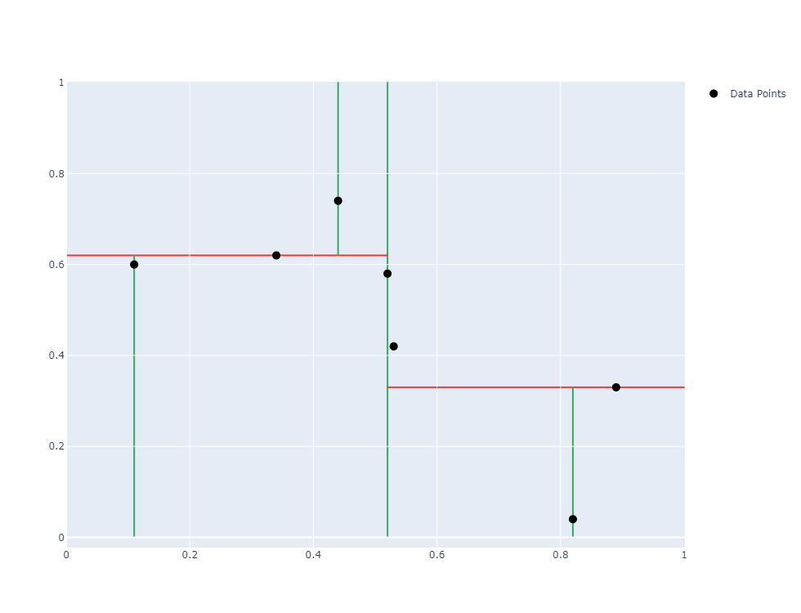
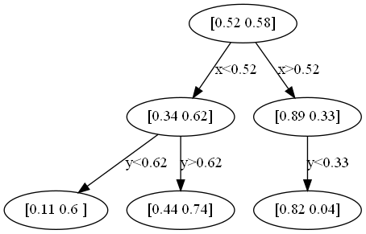

Slide 14
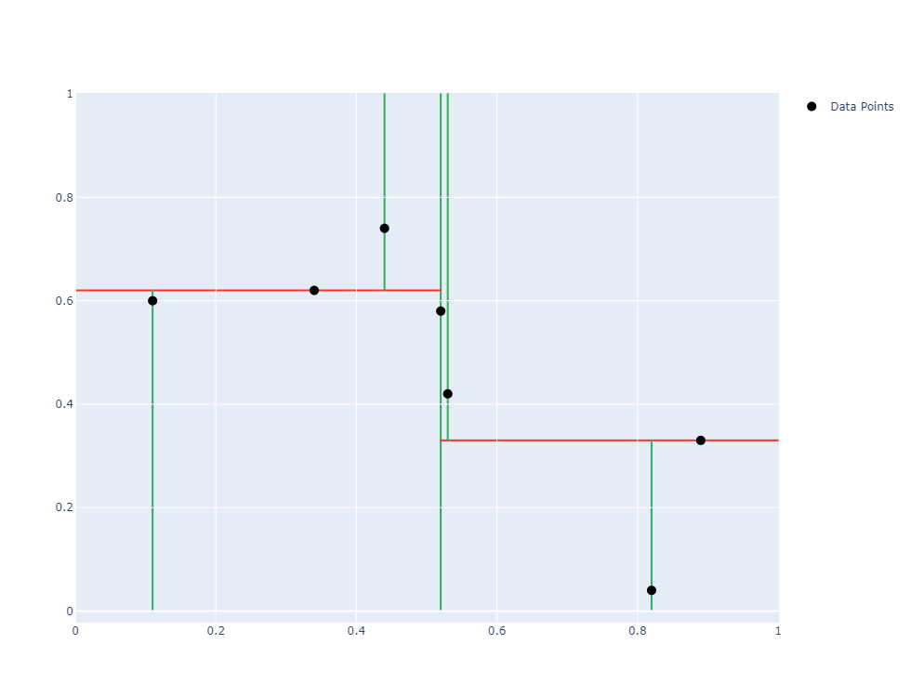
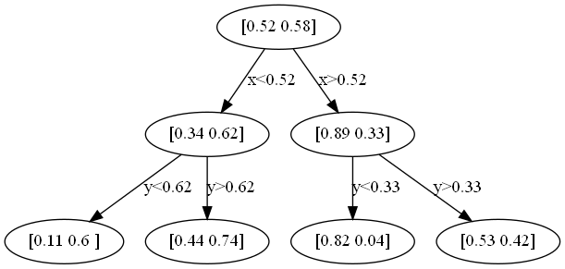

Slide 15
Insertion

Slide 16
Insertion
Start traversing the tree from the root
Compare point to insert with current node
Choose left or right subtree depending on comparison
Traverse until leaf is reached
Insert node below the leaf depending on its relative position
Warning:
Tree may become unbalanced during insertions (NN-Search performance suffers)
Rebalancing steps possible

Slide 18
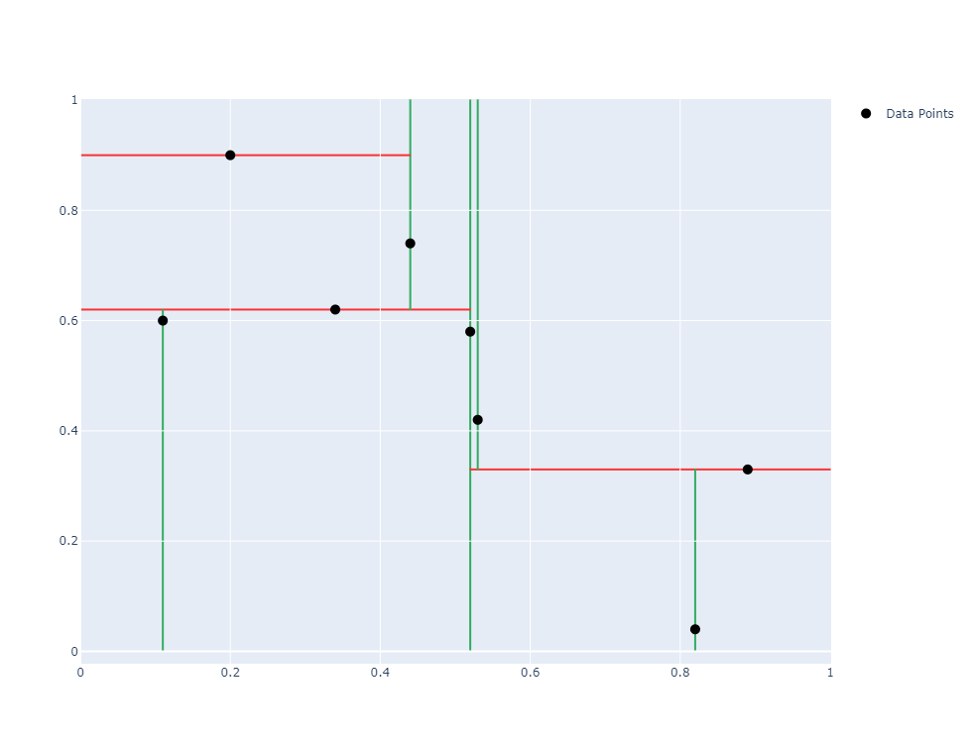
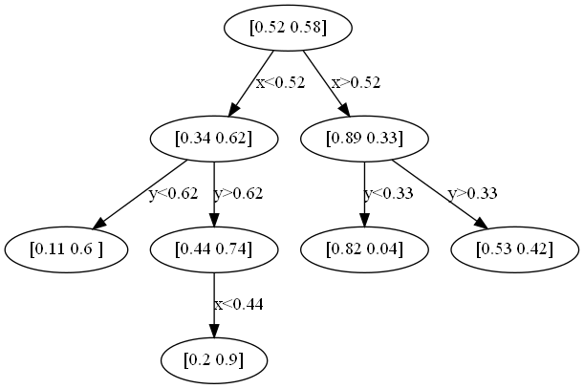

Slide 19
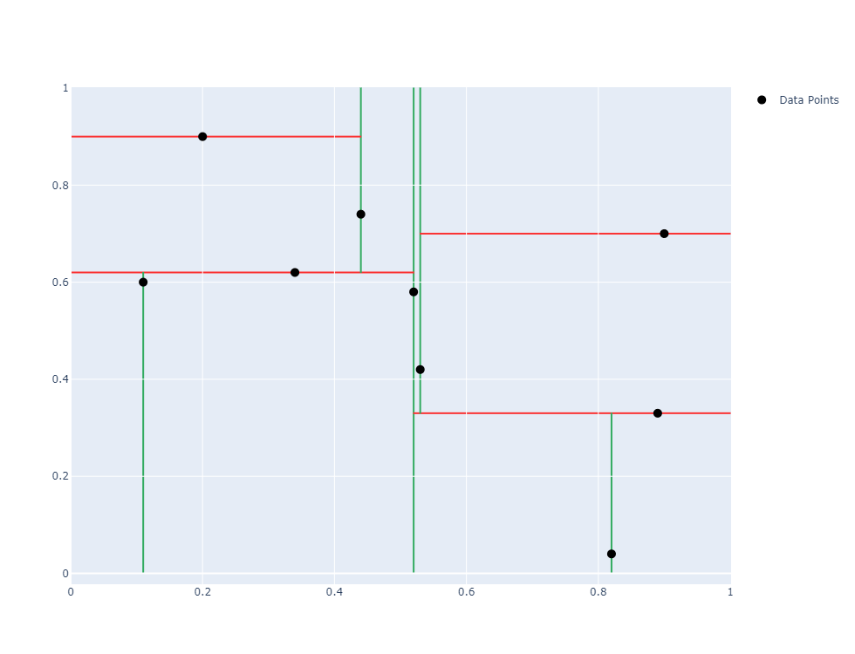
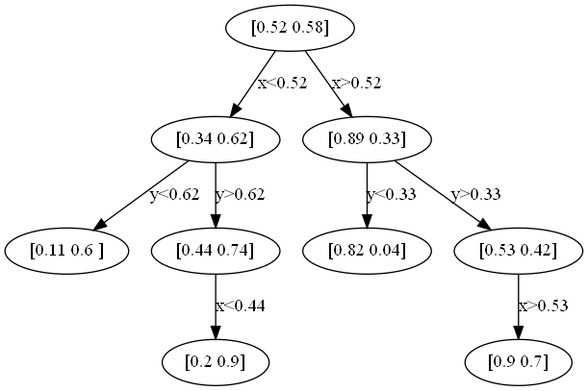

Slide 20
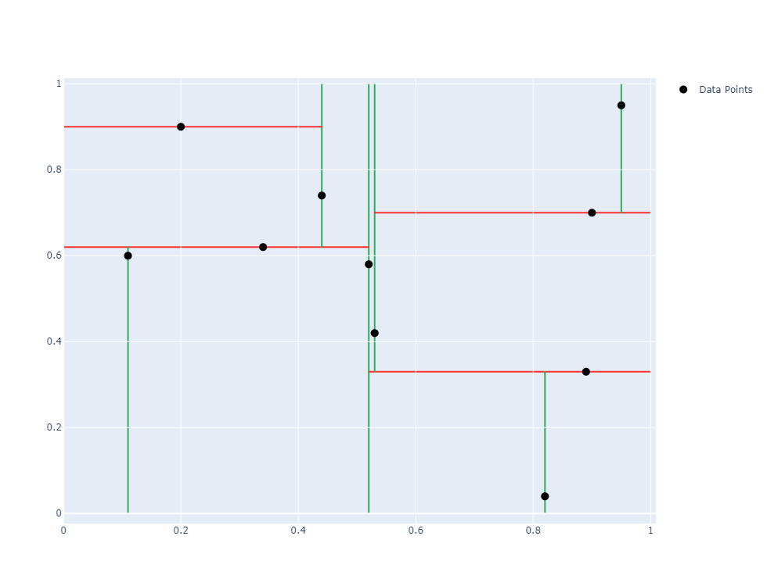
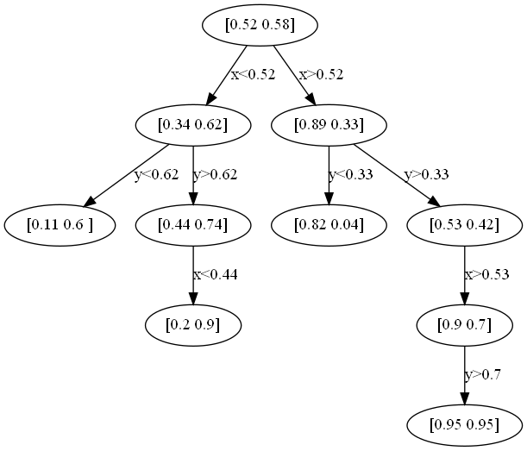

Slide 21
Deletion

Slide 22
Deletion
Start traversing the tree from the root
if current node == target node
find “in-order successor” in right subtree
replace current node with “in-order successor”
recursively start deletion from “in-order successor”
else
if current.left.contains(target): repeat 1. from current.left
else: repeat 1. from current.right
Warning:
Tree may become unbalanced during insertions (NN-Search performance suffers)
Rebalancing steps possible

Slide 27



Slide 28
Query / Lookup

Slide 29
Query
Start at root
Traverse tree down till search element is found or a not matching leaf is reached
At every node compare value to given condition
Traverse the subtree depending where the condition is true

Slide 35
Nearest Neighbor Search
start at root
move recursively down to leave
hypersphere around search point (radius = nearest distance)
crossed hyperplane to other branch -> maybe nearer points on the other side
if so search point moves down on the other side of the plane
if not other side is eliminated, search point moves up
ends at root

Slide 36
Variations

Slide 37
Variations and Related Versions
Adaptive kd-Tree
successive levels split along different dimensions
Implicit kd-Tree
defined implicitly above a rectilinear grid
Min/Max kd-Tree
min/max values of each inner node are equal to min/max values of a child note -> save memory
Relaxed kd-Tree
leaves of node do not have to have the same split axis
this relaxation allows insertions at arbitrary dimensions without reordering
Implicit kd-tree example
https://upload.wikimedia.org/wikipedia/commons/b/b7/Implicitmaxkdtree.gif
Last accessed 25.5.20

